Slide 1
Copy-Move Forgery Detection Using DCT
21AIE303
Group-8
Batch-A

Slide 2
21AIE303
SIGNAL AND
IMAGE Processing

Slide 3
TEAM MEMBERS
Sykam Sumanjali
CB.EN.U4AIE21068
Suda Haripriya
CB.EN.U4AIE21067
Reddy Hema Radhika
CB.EN.U4AIE21050
Souvik Gorain
CB.EN.U4AIE21065

Slide 4
Overview
Copy-Move Forgery Detection
Discrete Cosine Transform
Literature Survey
Proposed Method
Method Analysis
Results
Challenges and Future Work
PCA Algorithm
Comparison of PCA and DCT

Slide 5
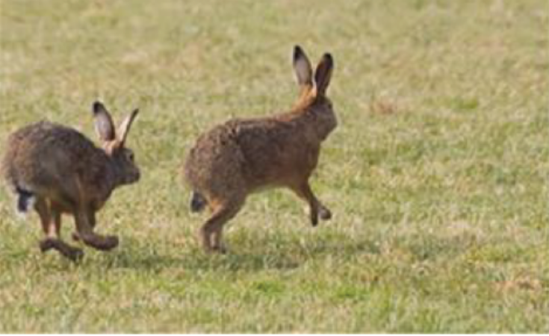
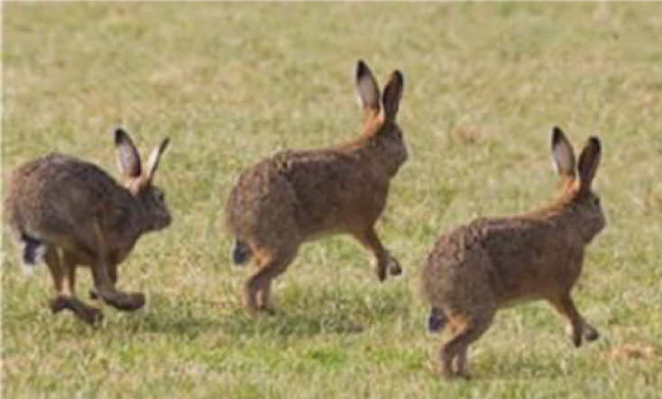
Copy-Move Forgery Detection
Definition : The copy-paste attack in which a part of the image is copied and pasted somewhere else in the same image with the intent to cover an important image feature.
Given an image with MN pixels (image of size M*N) our task is to determine if it contains duplicated regions of unknown location.
Original Image
Tampered Image

Slide 6
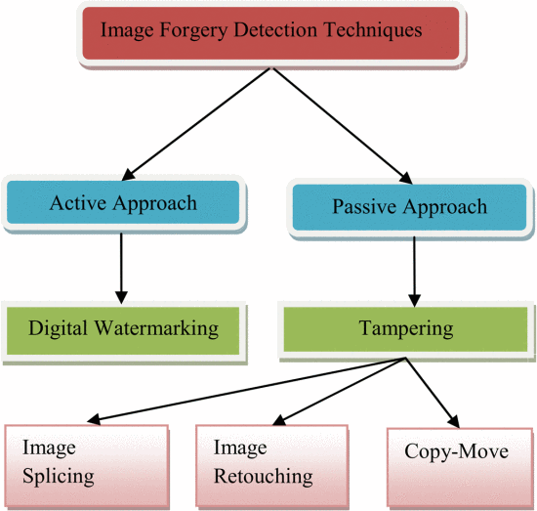
Flow Chart
Fig. 1. Forgery detection classification
Notes:
https://ieeexplore.ieee.org/document/6707675

Slide 7
Discrete Cosine Transform(DCT)
Important to numerous applications in science and engineering from lossy compression of audio and images, to spectral methods for the numerical solution of partial differential equations.
Fourier-related transform is similar to the Discrete Fourier transform (DFT), but using only real numbers.
Transforms an image from the spatial domain to the frequency domain.
Helps separate the image into parts of differing importance.
Expresses a finite sequence of data points in terms of a sum of cosine oscillating at different frequencies.
Notes:
https://en.wikipedia.org/wiki/Discrete_cosine_transform

Slide 8
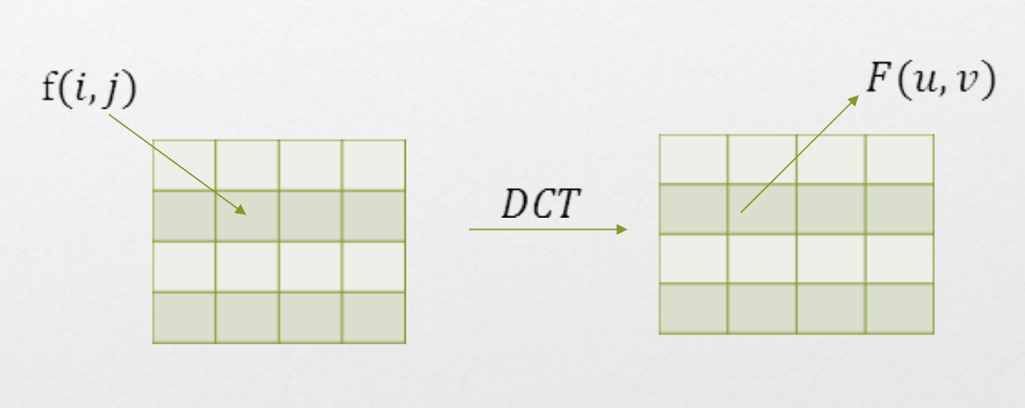
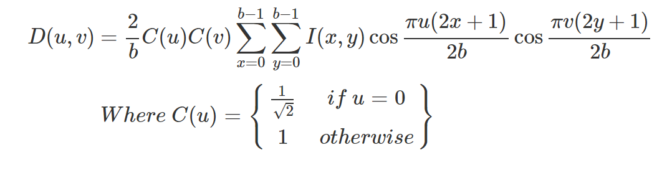
DCT(Contd…)

Slide 9
Literature Review
ASPECT | PAPER 1 | PAPER 2
Research Focus | Detection of copy move forgery in images | Detection of copy move forgery in digital images
Main Technique | Block Matching Algorithm | Discrete Cosine Transform
Challenges Addressed | Time complexity of block matching algorithms
Proposed Solution | Use of Discrete Cosine Transform (DCT) | Detection of region duplication forgery
Automation of Threshold | Effort made to automate threshold selection | Not specified
Feature Representation | DCT used for representing features | DCT used for detecting duplicated blocks
Image division Strategy | Overlapping blocks | Overlapping blocks
Perfomance Improvement | Addressed time complexity issues | Not explicitly mentioned
Scope for Improvement | Some issues remain unsolved or need improvement | Detection of tampering is a challenging task

Slide 10
Proposed Methodology (Python)
1) QuantizationMatrix Class:
Defines three quantization matrices Q50, Q75, and Q90 corresponding to different quality factors (QF).
Provides a method get_qm(qf) to get the quantization matrix based on the specified quality factor (qf).
2) read_img Function:
Reads an image using and converts it to grayscale.
Returns the grayscale image, the original color image, an overlay copy, and image dimensions.
3) dct Function:
Implements the Discrete Cosine Transform (DCT) for a 1D array.
Returns the transformed array.
4) create_quantize_dct Function:
Divides the input image into non-overlapping blocks of a specified size with a given stride.
Applies the DCT to each block.
Quantizes the DCT coefficients using an 8x8 quantization matrix (Q_8x8).
Returns a list of matrices, where each matrix corresponds to a quantized DCT block and its position in the image.

Slide 11
5) lexographic_sort Function:
Sorts the quantized DCT blocks lexicographically based on their flattened values.
Identifies matching blocks with similar DCT coefficients.
Calculates the shift vectors between matched blocks.
6) shift_vector_thresh Function:
Applies a threshold to the shift vectors to identify suspicious regions.
Returns the starting points of matched blocks that exceed the threshold.
7) Display_results Function:
Displays the original image with forged regions marked in red and original regions marked in green.
8) User Input and Execution:
Takes user input for parameters such as block size, quality factor, shift vector threshold, and stride.
Reads the input image and applies the forgery detection algorithm.
Displays the original and marked images.
9) Forgery Detection Process:
The forgery detection is based on the assumption that copied and pasted regions will have similar DCT coefficients.
Lexicographic sorting and shift vector analysis are used to identify matching blocks.
Matching blocks with significant shift vectors are considered potential forged regions.

Slide 12
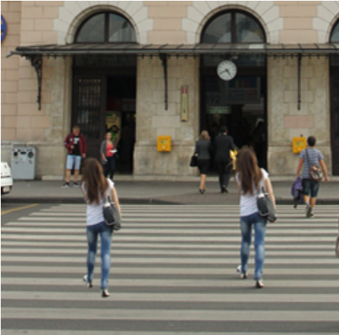
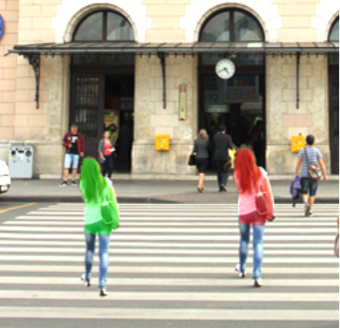
Results :
Original Image
Output Image
Forged regions marked in red, Original regions marked in green

Slide 13
Proposed Methodology (Matlab)
Different methods have been developed to detect the image forgery in digital images.
The proposed method uses the DCT coefficients to represent the overlapping block.
1) Convert the Color Image into Gray-Scale Image:
Color image, it can be converted to a grayscale image using the standard formula, I=0.299R+0.587G+0.114B. R,G,B represents the three-color components of RGB color model.
2) Divide the Gray-Scale Image into Overlapping Blocks:
Divide the gray-scale image into blocks of size 8×8.

Slide 14
3) Feature Extraction Using DCT: Apply DCT to each block for feature extraction.
4) Block Clustering Using K-Means Algorithm: Group the feature vectors (DCT coefficients) using the K-Means clustering algorithm.
5) Duplicate Detection: Identify groups of similar blocks within each cluster. Compare DCT coefficients of neighboring blocks to find similarities. Calculate the Euclidean distance between similar blocks. Mark duplicate regions in the result image with red rectangles.
6) Display Original and Duplicate Markers: Display a new figure showing the original and duplicate markers. Original markers are shown in green, and duplicate markers are shown in red.
7) Print Block Size and Execution Time: Print the selected block size to the console. Measure the execution time of the entire process. Display the execution time on the console.

Slide 15
Method Analysis
The method demonstrates a comprehensive approach, utilizing image preprocessing, feature extraction, clustering, and visualization to identify regions of potential manipulation.
The implemented method successfully identifies copy-move forgeries by analyzing DCT coefficients and utilizing clustering techniques.
Visual markers aid in distinguishing original and duplicate regions within the image.
The inclusion of execution time information provides insights into the algorithm's efficiency.

Slide 16
Challenges:
Noise and Compression Artifacts
Variability in Forging Techniques
Computational Complexity
Generalization Across Datasets
Limited Training Data
Future Work:
Deep Learning Integration
Multi-Modal Forgery Detection
Adaptive Algorithms

Slide 17
PCA Algorithm:
1. Given image convert into grey scale
Let N be total number of pixels and b denote number of square pixels in square block.
Using PCA
2. Find eigenvectors and eigenvalues.
3. Sort them in decreasing order.
4. Compute projections of centred testing gram matrix on ordered eigenvectors.
5. Lexicographically sort projected version of centred testing gram matrix denoted by S.
6. For every i^{th} rows i in S, select no. of subsequent rows, sj such that |i-j|<=R^{th} and place all pairs of coordinates (xi,yi) and (xj,yj) on to list P_in.
7. Compute offset for each row of P_in.
8. Compute frequency offset.
9. Those rows in P_in which have high frequency offsets are duplicated regions.
Notes:
https://ieeexplore.ieee.org/document/8125021

Slide 18
Comparison of PCA And DCT:
DCT vs. PCA Time Complexity:
DCT demonstrates quicker processing times due to its inherent dimension reduction properties.
Modified matching algorithms with DCT enhance overall efficiency without compromising on robustness, providing a faster alternative compared to PCA.
JPEG Image Considerations:
DCT is superior to PCA, especially for detecting forgeries in JPEG images.
The efficiency of DCT makes it a preferable choice for identifying and mitigating tampering in JPEG images compared to using predefined methods like PCA.
PCA is less robust against small rotations of copy-moved regions, impacting detection accuracy in scenarios involving slight rotations.

